Slide 1



US SOCCER FEDERATION
Ideas For Coaching the 10-11 Year Old Player

Slide 2
Who Are You Coaching?
What Are Your Objectives?
What Is the Environment?
Some Games That Teach

Slide 3
YOUR PLAYERS
10 and 11 year olds
4th and 5th Graders!
Focus?
Action over thought
Some kids more focused than others
Lessons from last practice may carry over to next practice

Slide 4
Some Common Soccer Challenges
Having the confidence and tools to keep the ball (on their own, and then with others)
Seeing more than themselves
Recognizing simple pressure
Recognizing option other than “straight ahead”

Slide 5
YOUR OBJECTIVES
Build the skill base
Let them experience the game
Keep it simple
Fun and competitive

Slide 6
BUILDING YOUR PRACTICE
Creating a soccer environment

Slide 7
SMALL NUMBERS
Lots of touches
Lots of repetition of simple but crucial situations (1v1, 2v1, 2v2, 3v2)
Lots of chances to score goals!

Slide 8
SHORT & SWEET
60 to 75 minutes of action
No more than 4 steps
“Water” Breaks

Slide 9
WHAT ELSE?
Remember to play to goals
Field size
Uneven skill level?

Slide 10
MATCHES
Keep Them Local
A chance to practice their tools from the week
A competitive focus for the players
Some different faces
Should NOT be mini adult league

Slide 11
EXERCISES FOR THIS AGE
A Few Games With Many Twists
Each adjustment shifts focus of challenge or level of challenge

Slide 12
PRACTICE GAMES
“Dribble, feint, shot”
1v1 and 2v1
“End line Dribble”
“4 square game”
6 goal game “dribble or pass”
4v4 or 5v5 with and without GK

Slide 13
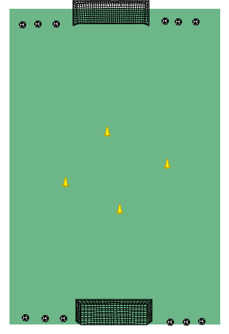
DRIBBLING, FEINTS & SHOTS

Slide 14
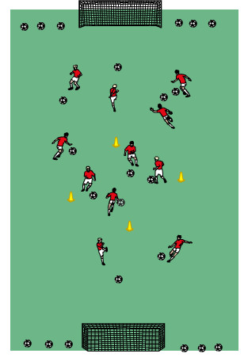
DRIBBLING, FEINTS & SHOTS

Slide 15
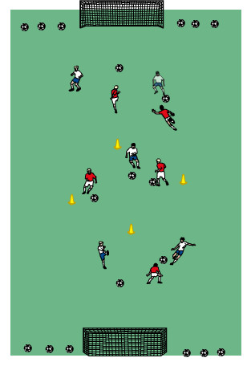
BLUE v RED

Slide 16
LAYERING
Repeated and isolated feints (no shots)
Add shots – must enter central grid before next shot
5v5 with multiple balls (each player keeps own score)

Slide 17
Count your own goals
Shots from outside a designated area
a) Awareness (goal, area, teammates)
Adjust number of balls
a) Level of difficulty
b) Level of focus

Slide 18
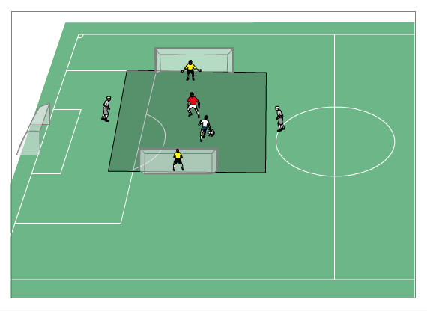
1v1 to 2v1

Slide 19


Slide 20
LAYERING
1v1 (encourage boldness)
1v1 with outside neutrals
1v1 with option to play-in teammate
a) Must receive ball on field
b) must be on-side.

Slide 21
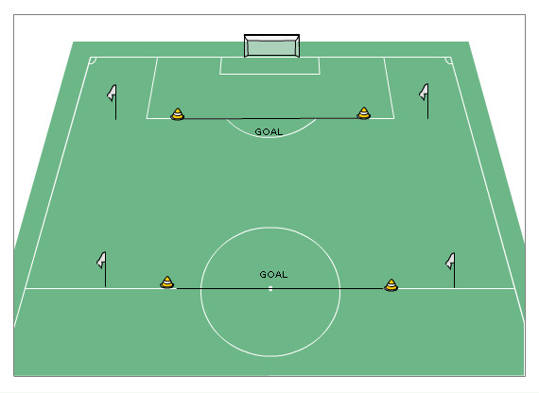
END LINE DRIBBLE GAME

Slide 22
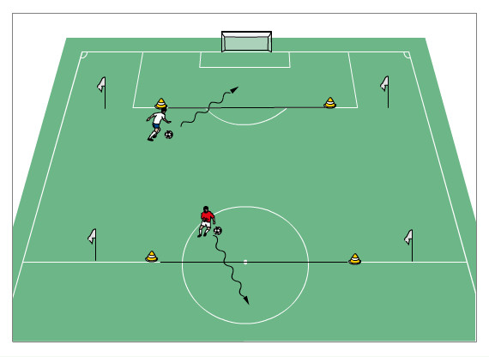

Slide 23
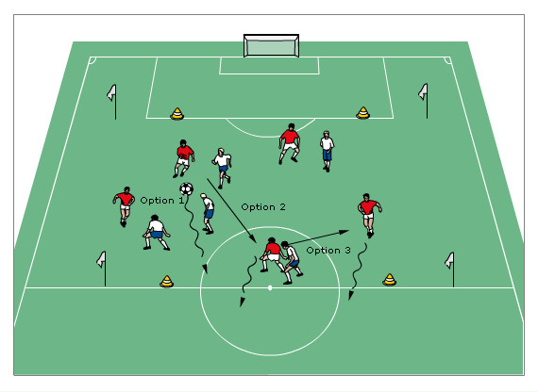
4v4 or 5v5 END LINE DRIBBLE

Slide 24
LAYERING OF THE GAME
Adjust the central “goal” area to be larger or smaller.
Increase the number of balls available
Each player keeps his own score
One or two balls, each team keeps its own score

Slide 25
Timed
Number of goals
One point for using a specific feint

Slide 26
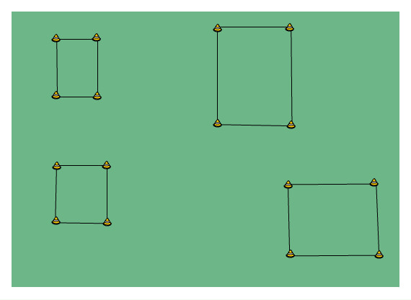
FOUR SQUARE GAME

Slide 27
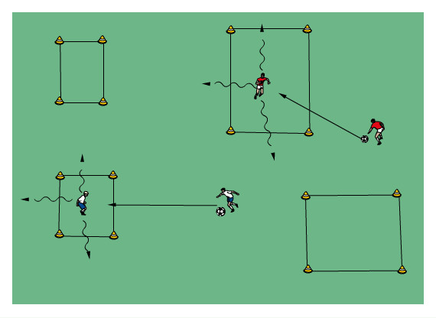

Slide 28
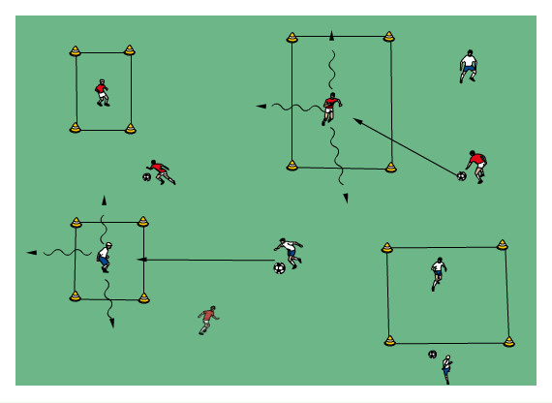

Slide 29
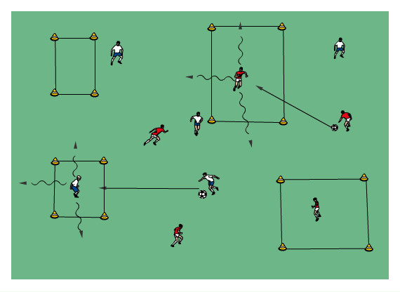

Slide 30
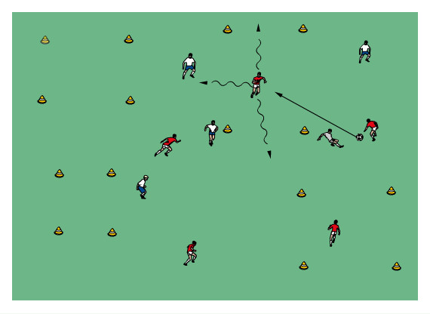

Slide 31
LAYERING OF THE GAME
In pairs (one ball between two)
In teams (one ball per team)
In teams (two balls)
In teams (one ball)

Slide 32
Timed
Number of goals
Can’t exit through same gate that the pass entered.
Can’t score at the same square twice in a row.
Can’t score with the same player combination twice in a row

Slide 33
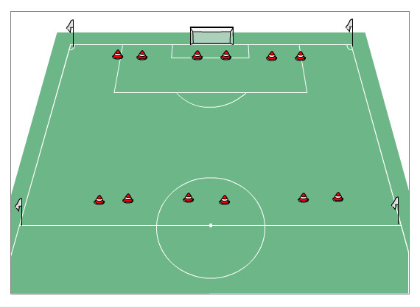
6 GOAL DRIBBLE OR PASS

Slide 34
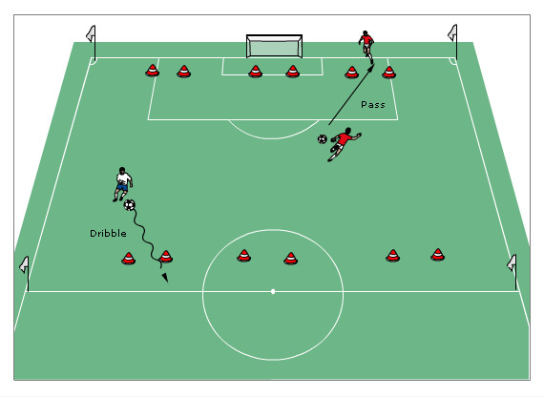

Slide 35
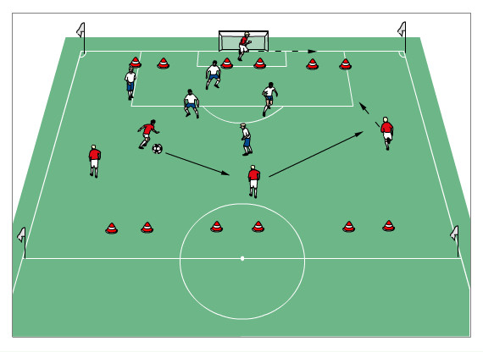

Slide 36
LAYERING OF THE GAME
One ball for each team
Two balls and two teams
One ball and two teams
Add a “neutral” player onto the field
One “target” for each team
Anyone can be a “target”

Slide 37
Goal by dribble only
Goal by pass only
Goal by dribble, pass or 5 consecutive passes between players

Slide 38
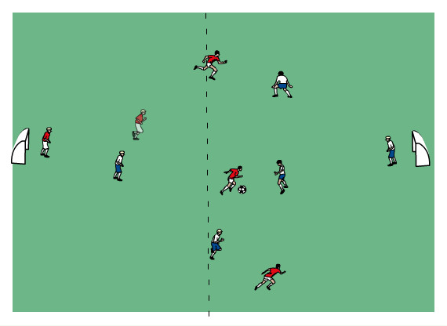
4v4 or 5v5

Slide 39
LAYERING
With and without goal keepers
Change (both) goalkeepers on every goal
Change (both) goalkeepers on every shot
With and without off side
One point for ball in net and one point for 6 consecutive passes

